Slide 1


Daria Solodey
Methodist, course creator

Slide 2


Slide 3

Lesson Plan:
Discuss what confidence is and why it’s important
Study tips to become more confident
Answer the question:
What are your career development goals?
Notes:
Развернутый комментарий.

Slide 4




Look at the pictures. Read the sentences and phrases. What do they have in common?

Slide 5
Have you ever felt nervous, worried or stressed before an important exam or presentation?
Do you always believe in yourself?
What do you usually do to feel better?
We are going to watch the video called
"3 tips to boost your confidence".
What do you think the video is going to be about?
🤔

Slide 6










Match the pictures with the words
1 2 3 4 5
advice, attempt, excitement, power, failure, development, abilities, self-esteem, confidence
6 7 8 9 10

Slide 7
Match the pictures with the words
1 2 3 4 5
5 advice, 8 attempt, 10 excitement, 9 power, 2 failure, 4 development, 7 abilities,
1 self-esteem, 3 confidence
6 7 8 9 10

Slide 8

Look at the word cloud. They are nouns. Make a chain story with the given words.
Rules:
A student makes a full sentence with any word from the picture. Next student repeats the sentence and adds a new one. The last one repeats all the sentences.

Slide 9

Look at the word cloud. They are adjectives.
Check your understanding and play the game.

Slide 10
You have 20 seconds to memorise the words.
Then the slide will be closed and you are to name as many words as you are able to. The best player wins.

Slide 11

Match the words with their halves and then with the meanings.
Watch the first part of the video (0-1:25) and answer the questions.
What is "confidence"?
Where does it come from?
What is confidence for you?
Are you a confident person?

Slide 12
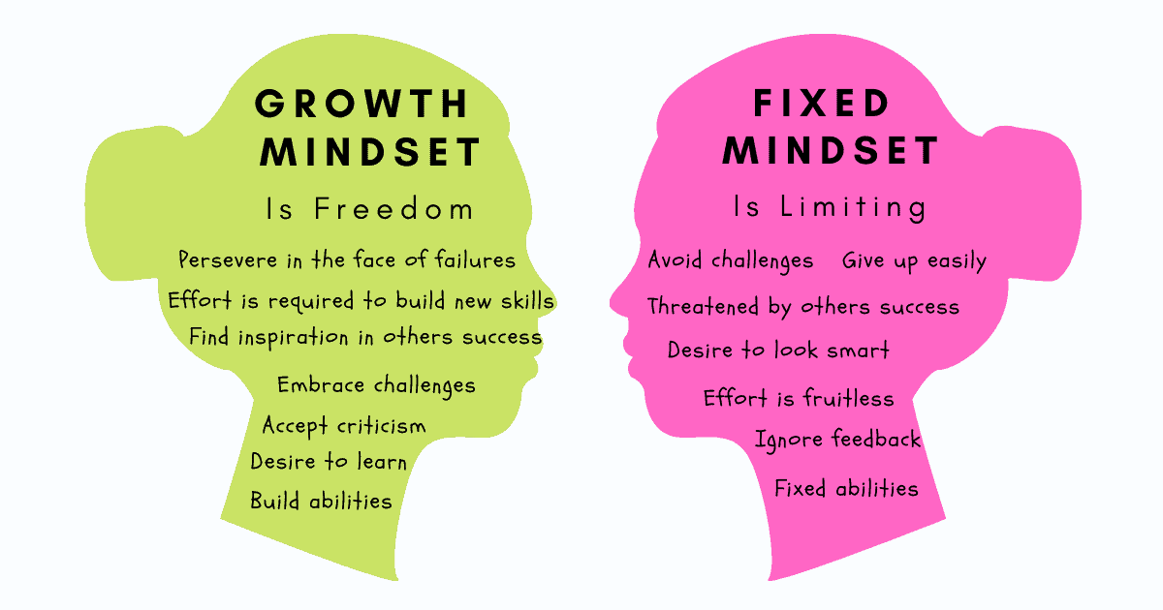
What do these collocations mean?
To boost confidence
To give yourself a pep talk
To picture your success
To strike a powerful pose
To promote feeling of power

Slide 13
Watch the second part of the video. What are the tips given in the video? What is the best tip to boost your confidence in your opinion? Why?
What was the last challenge you faced? How did you respond to it?
What practical tips would you give someone before an important presentation?

Slide 14

What pep talk would you give yourself before an exam?
Do you have a fixed or growth mindset? Why do you think so?
Is it important to look confident at the interview? Why?

Slide 15

Imagine that you are in a job interview with Mark Zuckerberg and he is asking you the question. What will your say?
Tips:
Be creative but realistic
Show ambition
Talk about your goals
Useful phrases:
to boost my confidence
to be able to face a challenge head-on
to learn new skills
to become an expert in ____
to be valuable and competent
to become a true team leader
to increase my performance metrics
......
Hey, what are your career development goals?

Slide 16

What have you learnt this lesson?
I learned:
What is confidence and why it’s important
Tips to become more confident
How to answer the question:
What are your career development goals?
Notes:
Развернутый комментарий

Slide 17
Useful links:
Game:
https://wordwall.net/embed/6c44b8eb6d83424cbad432d5b39a9186?themeId=1&templateId=35%22
Words from this lesson:

Slide 18
Thank you!

